Slide 1
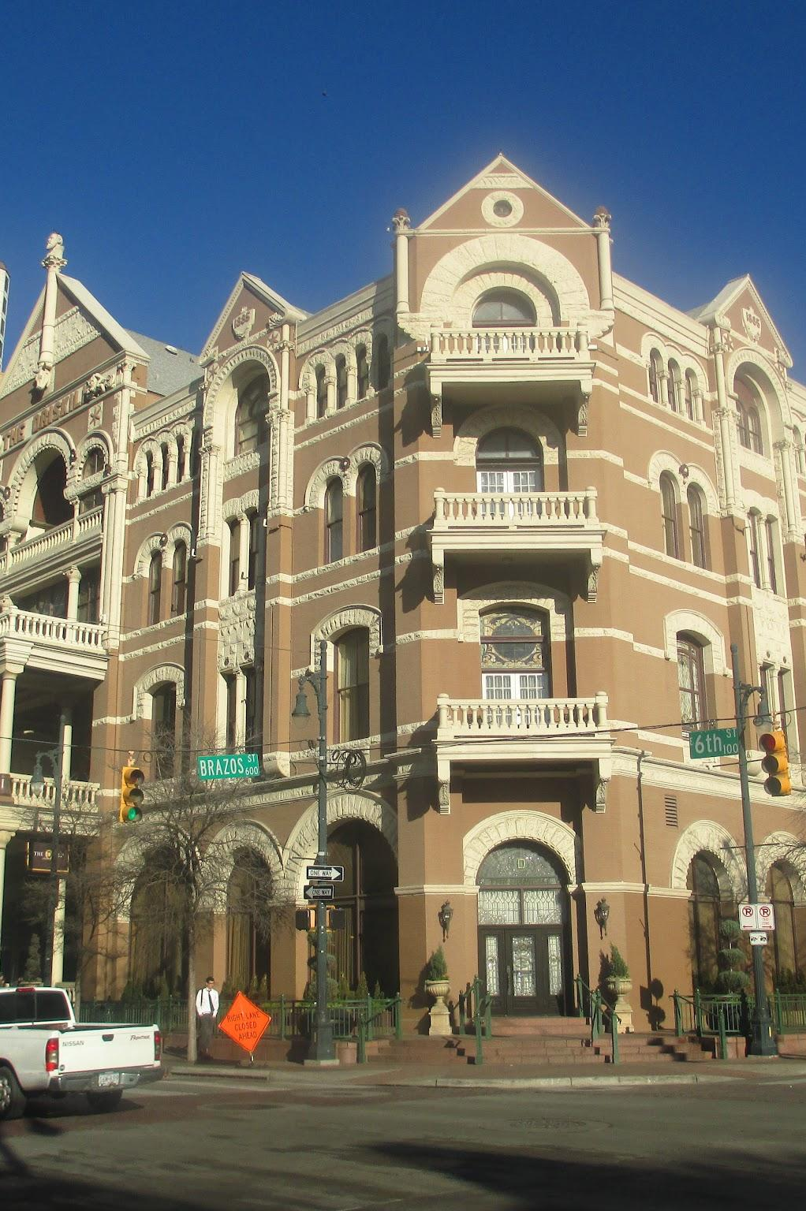
Revenue Management For Hotel Bookings
Amey Ghate
Sameer Ahmed
Spandan Pal

Slide 2
TABLE OF CONTENTS
01
02
03
04
05
Introduction and Problem Statement
Dataset
Analysis
Results
Future Work

Slide 3
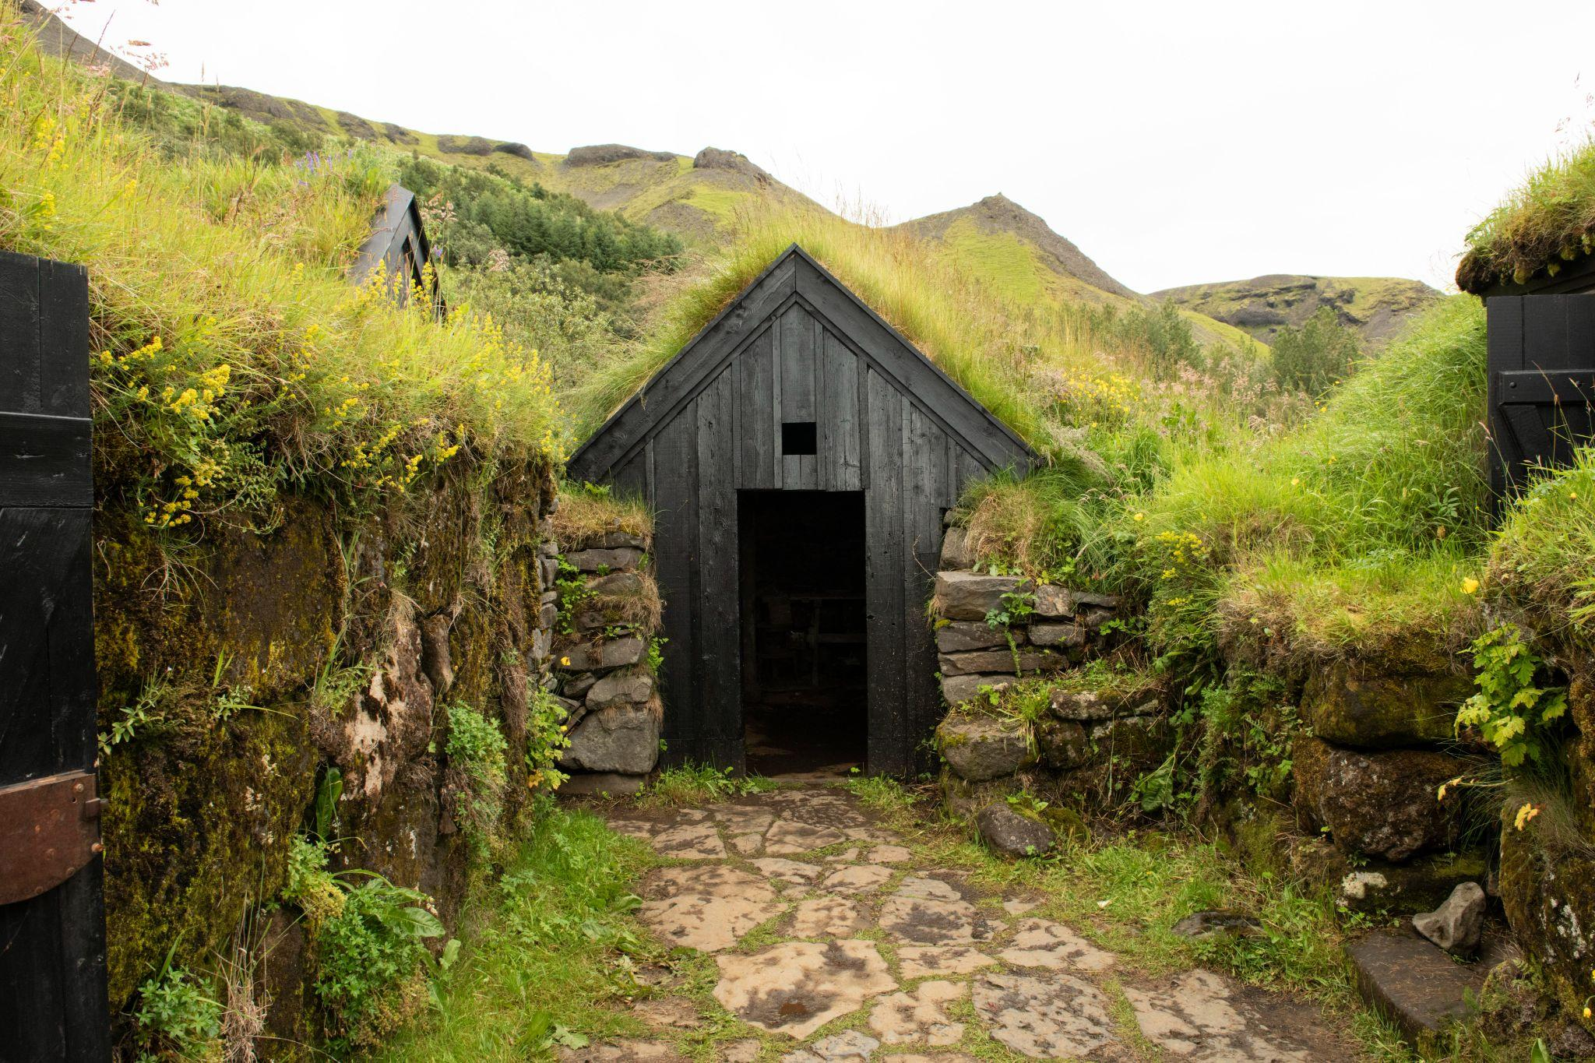
01
Introduction and Problem Statement

Slide 4

Introduction and Problem Statement
The hotel has 100 rooms to sell. This presents a dilemma for the management team:
Problem: How should one determine whether the rooms should be sold to a transient or a group?
How should the business proceed? Should it accept the lower-paying offer now and secure the revenue, or should it wait for a potential higher-paying guest who may or may not arrive?
Variables: The number of rooms to be reserved for higher-paying guests.
Ideally, the hotel should set aside sufficient rooms for the higher-paying guests and sell the rest to groups.

Slide 5
02
Dataset

Slide 6
Overview of Dataset used
Data Source
Data Features
This analysis was conducted using the "Hotel Booking Demand" dataset from Kaggle, which contains comprehensive booking information for hotels.
There are 119,390 entries in the dataset, which contain details on booking status, customer type, stay duration, daily rates applicable to different market segments, etc.

Slide 7
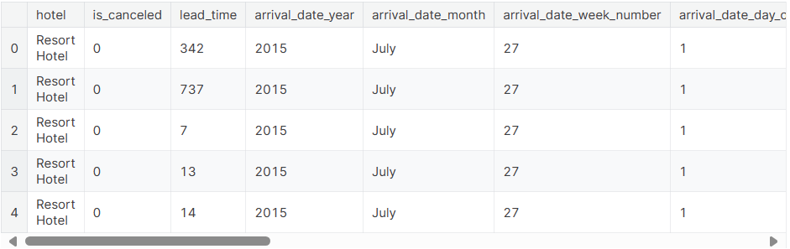
Overview of Dataset used
In this dataset there are 32 columns. For our problem, we are only interested in bookings that stayed. Therefore, we analyzed the is_canceled column, removing all canceled and no-show bookings.

Slide 8
03
ANALYSIS

Slide 9
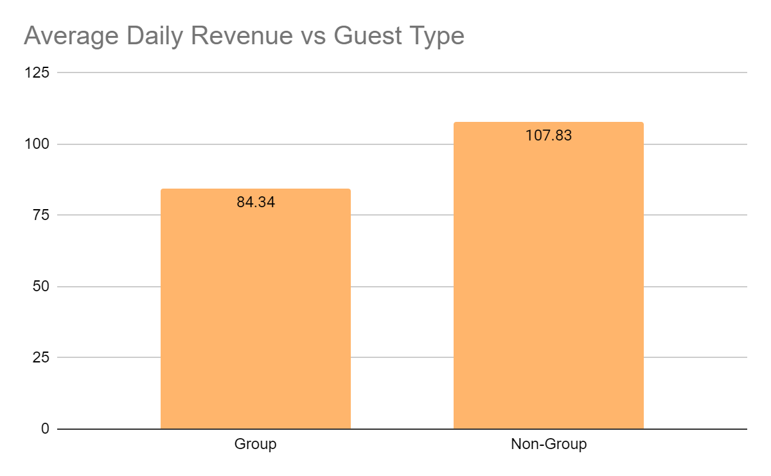
CAPACITY CONTROL MODEL
Problem:
How do we decide if we should sell the room to a high value guest?
How many rooms do we set aside for a high value guest?
Expected Revenue =
(Outcome Revenue) * (Probability of Outcome)
Capacity Control Model would choose the outcome with the greater Expected Revenue.
If group(Expected Revenue) < non_group(Expected Revenue), then we hold the rooms for High Value Guest
Else if group(Expected Revenue) > non_group(Expected Revenue), then we give the room to Groups/
Group Segment has a lower ADR. Thus, Capacity Control Model makes sense here.
Note:
All bookings are set to have Length of Stay = 1
Considering only two room classes
Cancelled or No-Show cases are not being considered

Slide 10
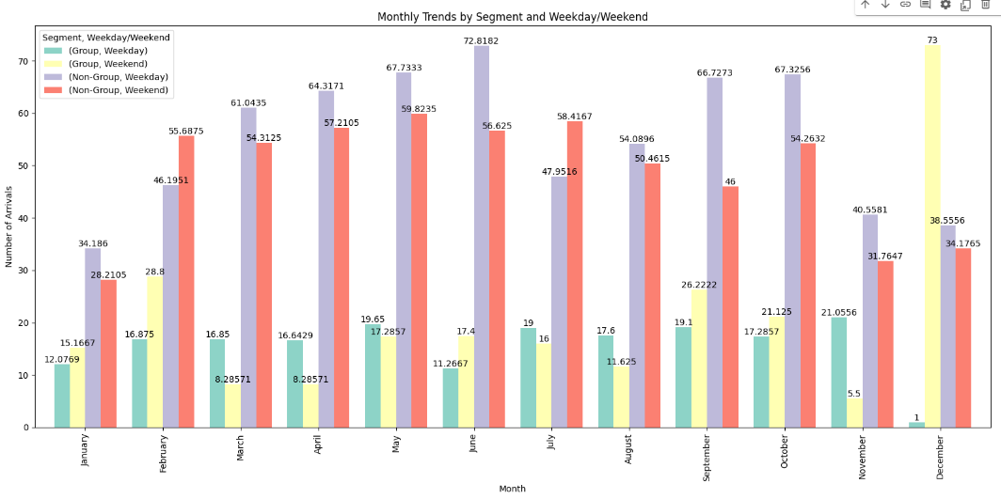
SEASONALITY
Group and Non-Group Customers have different trends
Non-Group arrivals are stronger in the weekends (except in Feb and July)
Non-Group arrivals have the highest values during May, June, Sept and Oct
Non-Group arrivals have the lowest values from Nov to Jan
Group arrivals do not have a clear seasonality

Slide 11

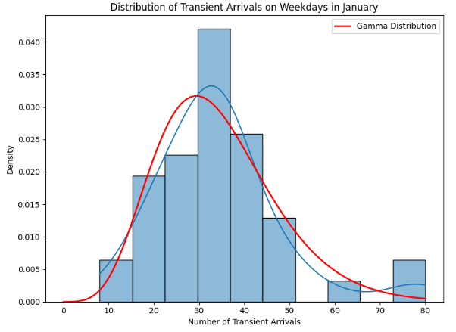
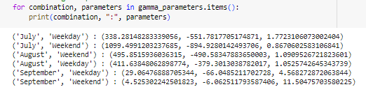
NON-GROUP ARRIVAL DISTRIBUTION
We try to estimate the probability distribution function for the Non-Group Arrival Distribution
Gamma Distribution seems to fit the Non-Group Arrivals data well
The k, θ, μ for the Non-Group Arrivals is then estimated for each combination of Month and Weekday/Weekend

Slide 12
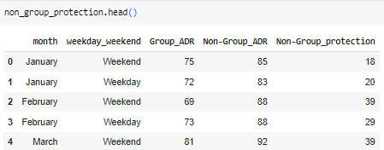
OPTIMAL POLICY
Using Littlewood’s Rule here,
If (Probability of selling more than X number of High Value guests) > (Revenue From Group Room)/(Revenue From Non-Group Room)
Then, we set aside X number of rooms for High Value guests
We calculate X here using the inverse survivor function
For Example, for Jan & Weekend,
Non-Group Protection = inverse_survivor_fn(75/85) = 18.4306 ~ 18
So, the Optimal Policy For a January Weekend will be to reserve 18 rooms from Non-Group High Value Guests and book the remaining 82 rooms for Groups.

Slide 13
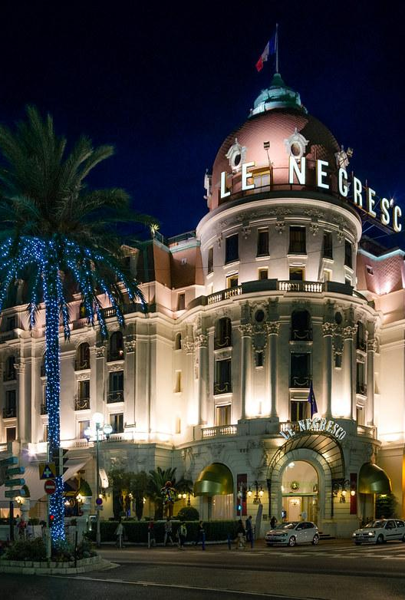
04
RESULTS

Slide 14
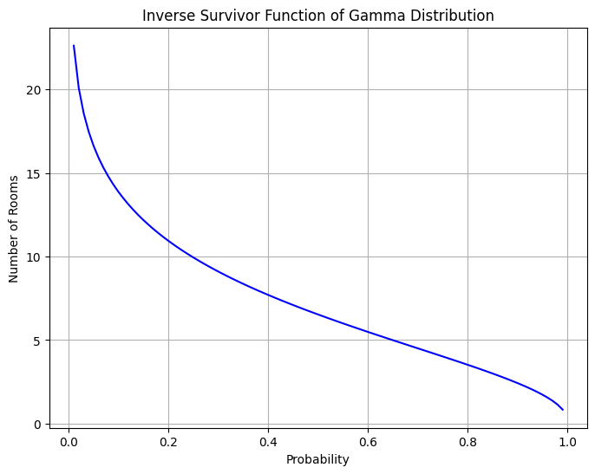
BUILDING THE FINAL ANALYSIS
LITTLEWOODS RULE
We need the Probability ratio of Group ADR and Transient ADR for each day. This ratio is interpreted as a measure of the relative value or profitability of group bookings compared to transient bookings.
INVERSE SURVIVOR FUNCTION
We will then plug in these probability ratios into our inverse probability distribution in order to determine the amount of rooms we should keep.

Slide 15
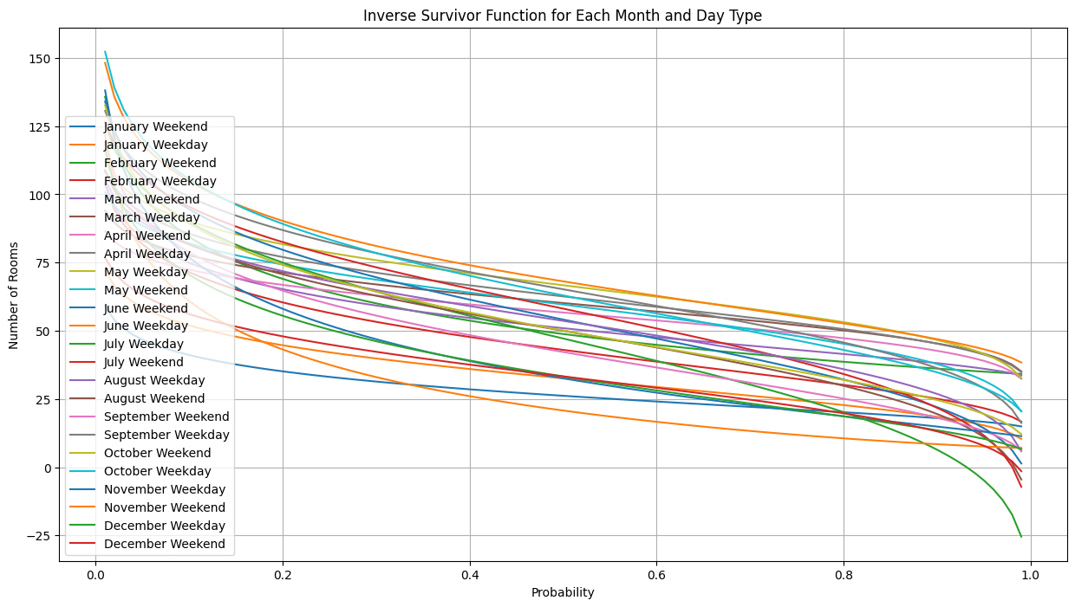
LOOKING AT THE SURVIVOR FUNCTION

Slide 16
HOW MANY ROOMS TO KEEP?

Slide 17
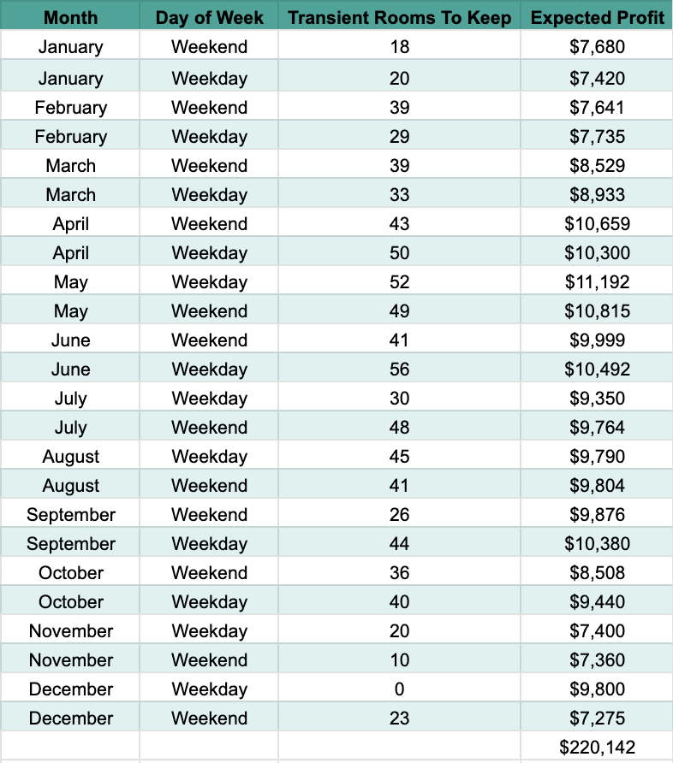
HOW MANY ROOMS TO KEEP?

Slide 18
EXPECTED PROFIT?

Slide 19
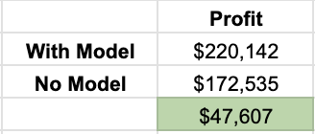
BENEFITS OF THE MODEL

Slide 20
05
FUTURE WORK

Slide 21
FUTURE WORK
Forecasting Models for Special Events
Integration of Online Booking Behavior
I
Integration with Marketing and Sales Campaigns
Implement forecasting models that specifically account for the impact of local events, conferences, and seasonal variations. This could involve creating predictive models that integrate external data sources like local event calendars, weather forecasts, and economic indicators.
Analyze online booking patterns, including the lead time and abandonment rate on the booking platform. Use this data to tweak the user interface, offer timely discounts, or adjust room recommendations to increase conversion rates.
Align revenue management strategies with marketing efforts. Analyze the impact of promotions and discounts on both immediate revenue and long-term customer loyalty. This integration can help in crafting offers that are both attractive to customers and profitable for the hotel.

Slide 22
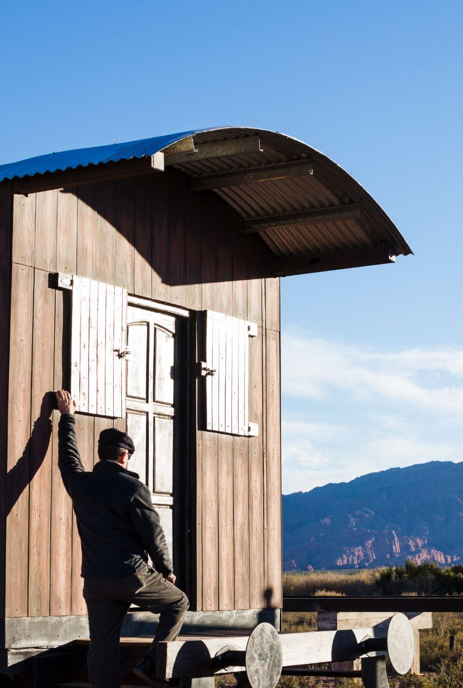
THANKS

